Slide 1
Research Computing Update
December 2020

Slide 2
HPC Resources
New HPC Procurement via ANKABUT
Hardware has been delivered and processed in time!
Will start planning and deployment in January 2021
HPC service planned to be up and running by early 2021
SAN HPC Cluster
SAN HPC cluster to be decommissioned by end of January 2021
Continuing with planning the migration of data
On-site Dell engineer will be leaving first week of January 2021, as contract is finished

Slide 3
Resource Utilization

Slide 4
KU Cluster core distribution

Slide 5
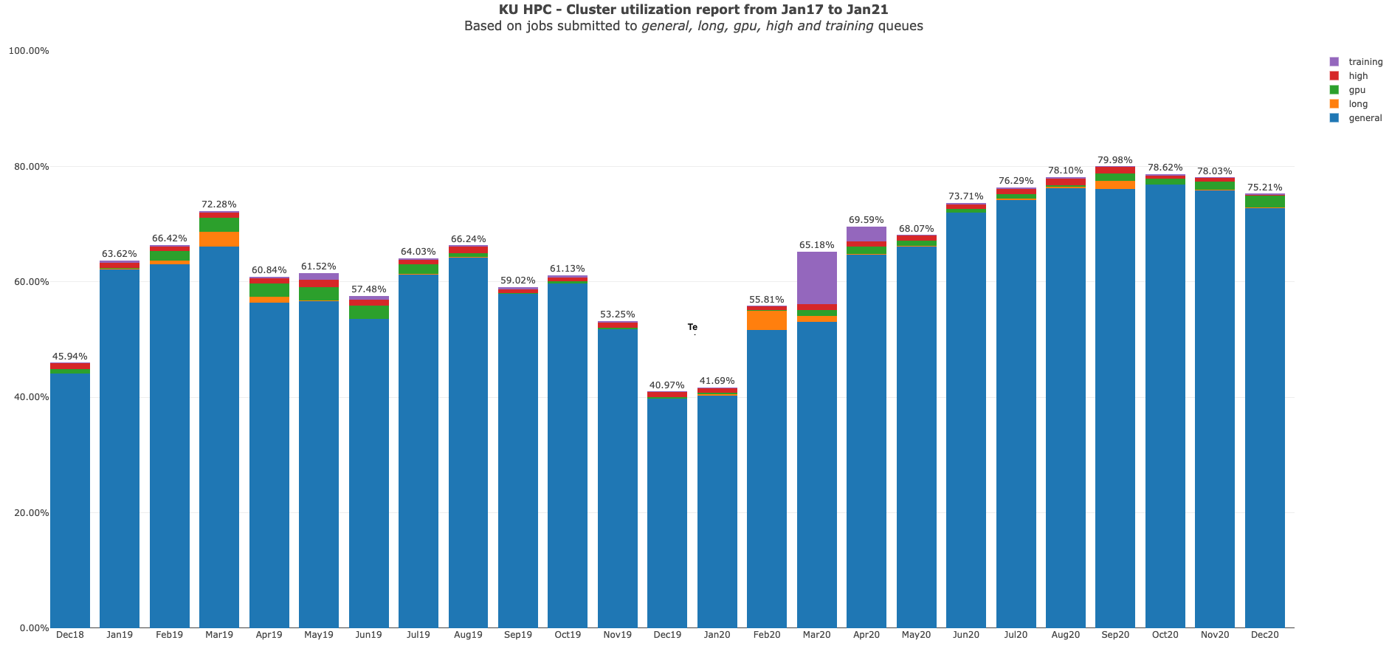

Slide 6
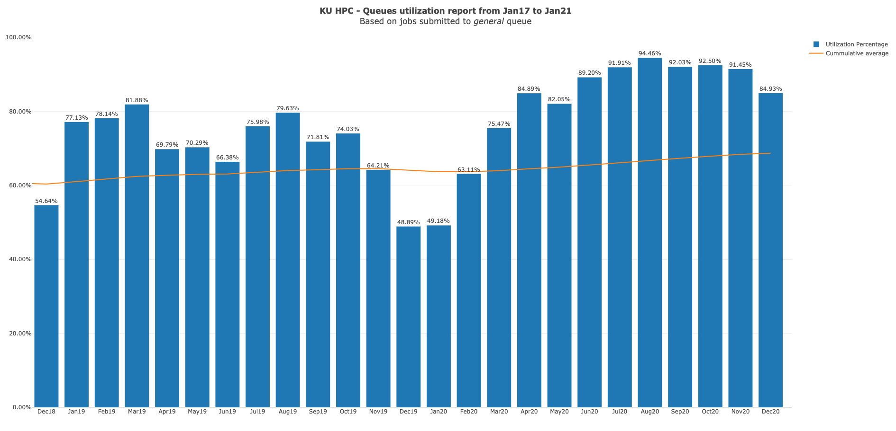

Slide 7
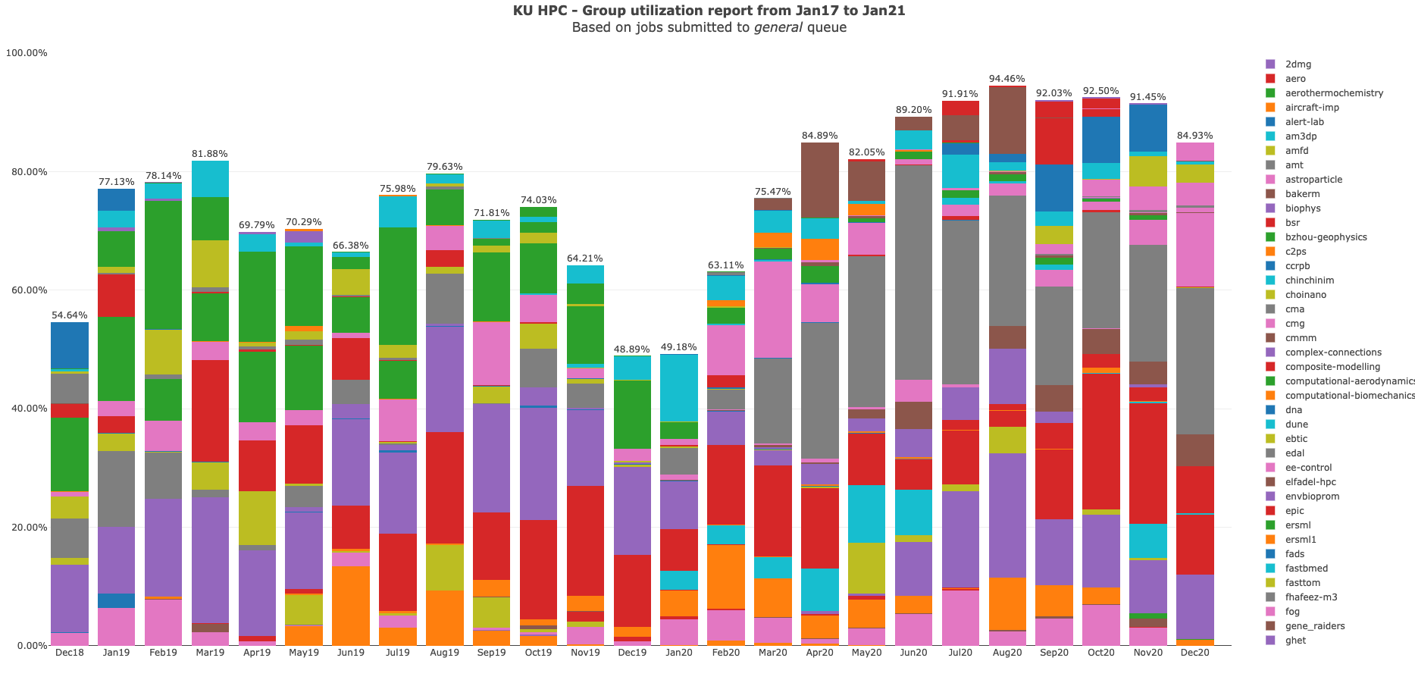

Slide 8
KU HPC Group Utilization for December 2020.
Note that do not yet keep track of applications used automatically. This is a work in progress, and will be added to future reports.

Slide 9
PI Cluster core distribution

Slide 10
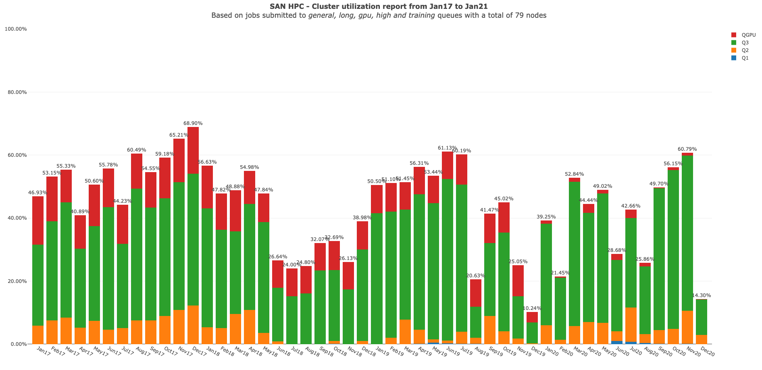

Slide 11
Status of KPI’s

